Slide 1



SWIGGY ANALYSIS
Presentation By: Ajay Kumar.G
Batch Code: MBT12

Slide 2
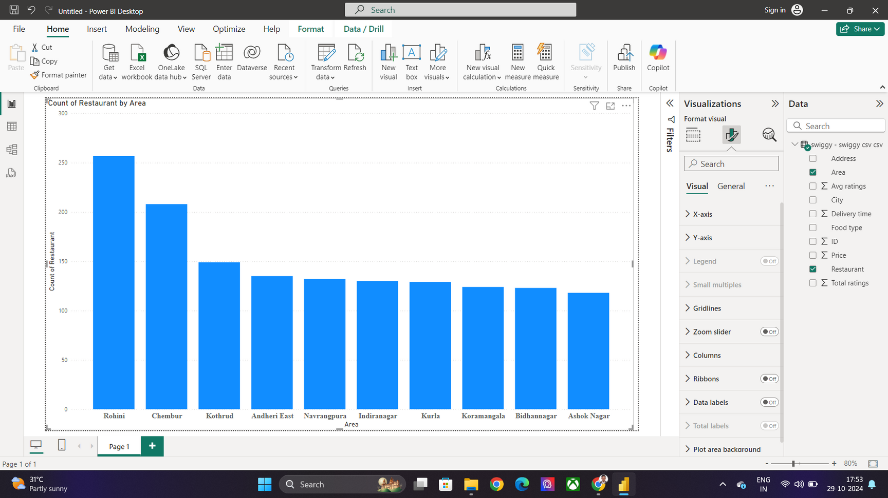
Task 1: Top 10 Areas with Most Restaurants
257
208
149
135
132
130
129
124
123
118
Conclusion:
This bar chart displays the count of restaurants in various areas. Rohini has the highest number of restaurants, with over 257, followed by Chembur with just above 208. The areas of Kothrud, Andheri East, Navrangpura, Indiranagar, and Kurla have moderate restaurant counts, each ranging from around 120 to 150. The remaining areas, including Koramangala, Bidhannagar, and Ashok Nagar, have slightly lower restaurant counts, close to 150. Overall, the data suggests that Rohini and Chembur are the most popular areas for restaurants among the listed locations.

Slide 3
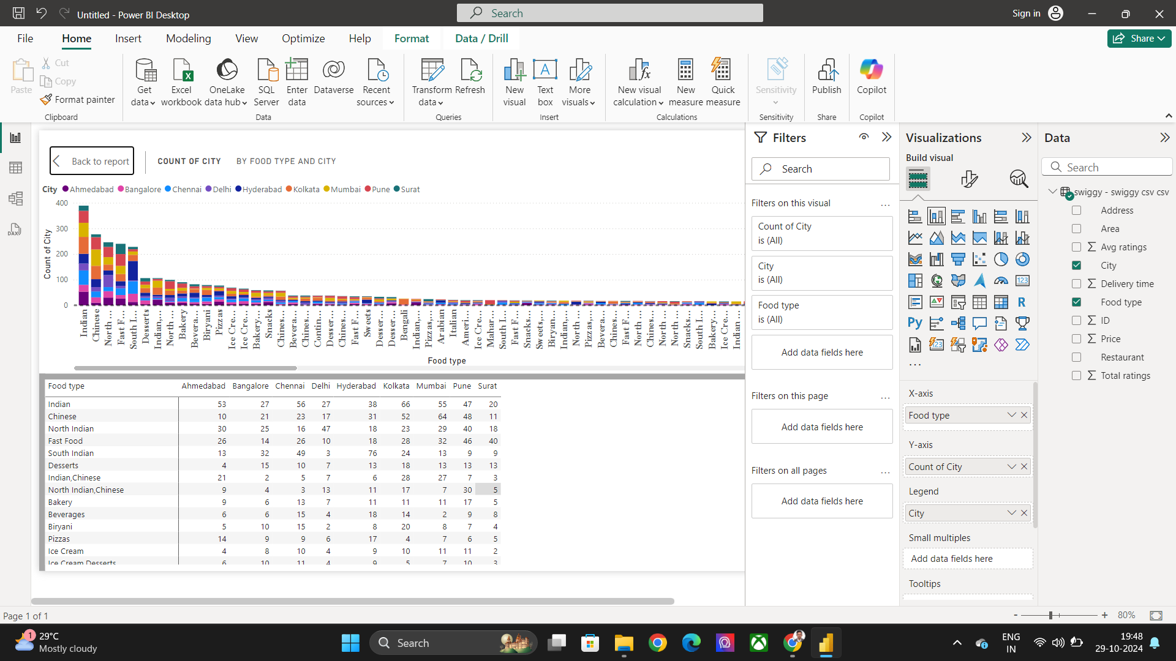
Task 2: Most Popular Food Types Served by Swiggy Restaurants in Each City
Conclusion:
Food diversity: The data indicates a wide range of food preferences across the cities, with Indian, Chinese, and North Indian cuisines being the most popular overall. Regional preferences: There are distinct regional preferences, with South Indian cuisine being particularly popular in Chennai and Hyderabad, and North Indian cuisine being more prevalent in Delhi. Fast food and desserts: Fast food and desserts are relatively less popular compared to other categories.Combination cuisines: Combinations of Indian and Chinese, and North Indian and Chinese are also popular in some cities.

Slide 4
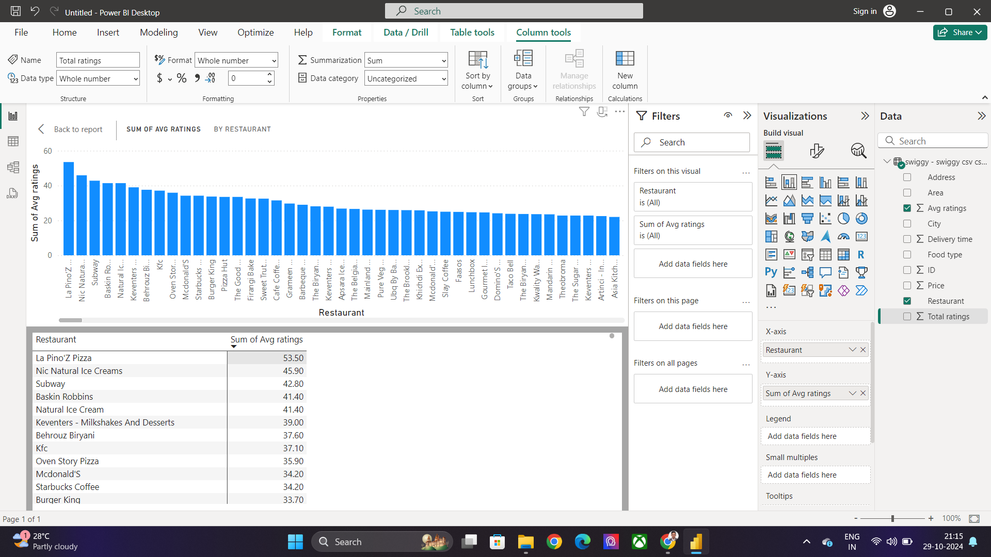
Task 3: Top Rated Swiggy Restaurants (In Percentage)
Conclusion
The top-rated Swiggy restaurants—La Pino's, Nic Natura, and Subway—reflect the diverse preferences and evolving trends in the food delivery market. La Pino's dominates with its indulgent, high-quality pizzas that cater to comfort food lovers. Nic Natura stands out for its focus on healthy, fresh, and nutrient-rich meals, attracting health-conscious customers. Meanwhile, Subway’s customization options, quick service, and healthier fast food choices make it a convenient and popular pick for those seeking a personalized meal experience.

Slide 5
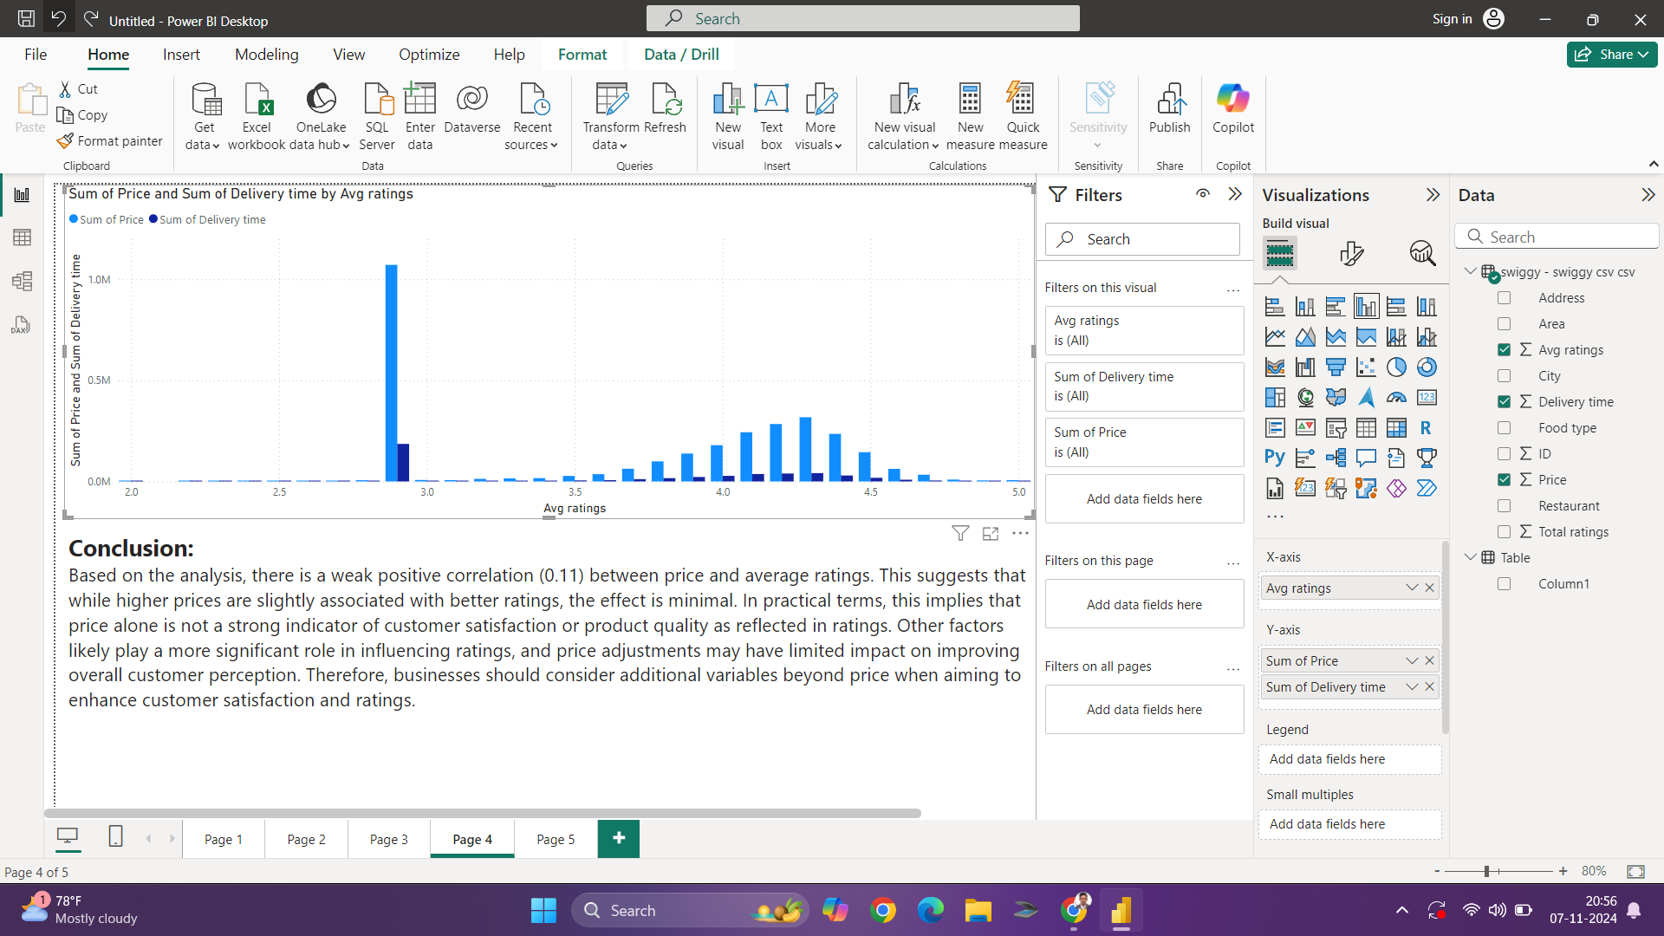
Task 4: Correlation of Factors Affecting Average Rating
Conclusion:
Based on the analysis, there is a weak positive correlation (0.11) between price and average ratings. This suggests that while higher prices are slightly associated with better ratings, the effect is minimal. In practical terms, this implies that price alone is not a strong indicator of customer satisfaction or product quality as reflected in ratings. Other factors likely play a more significant role in influencing ratings, and price adjustments may have limited impact on improving overall customer perception. Therefore, businesses should consider additional variables beyond price when aiming to enhance customer satisfaction and ratings.

Slide 6
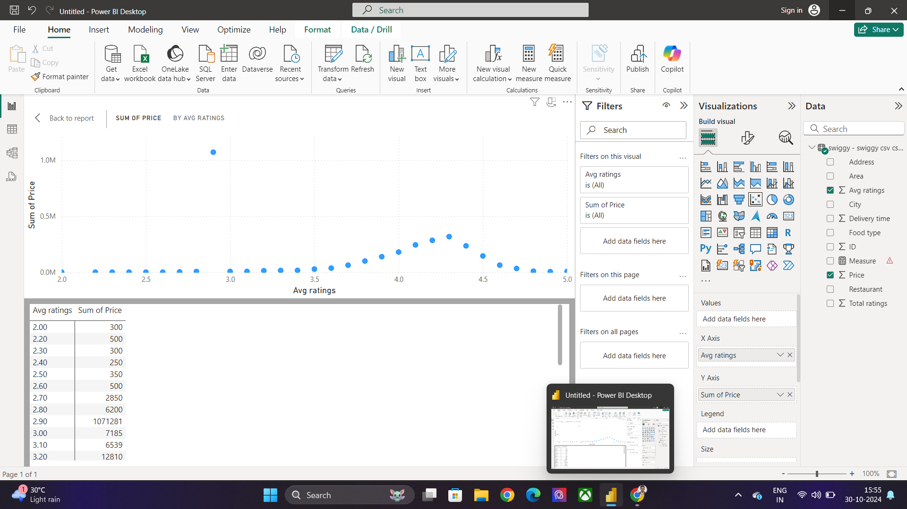
Task 5: Correlation Between Restaurant Price and Average Rating
Conclusion:
The correlation between restaurant price and average rating reveals an interesting dynamic in consumer behavior. While higher-priced restaurants may often be associated with premium ingredients, exceptional ambiance, or gourmet experiences, they do not always guarantee higher ratings. In fact, many consumers are more inclined to rate based on the overall value they perceive, which includes not just the quality of food, but also factors like service, convenience, and consistency.

Slide 7
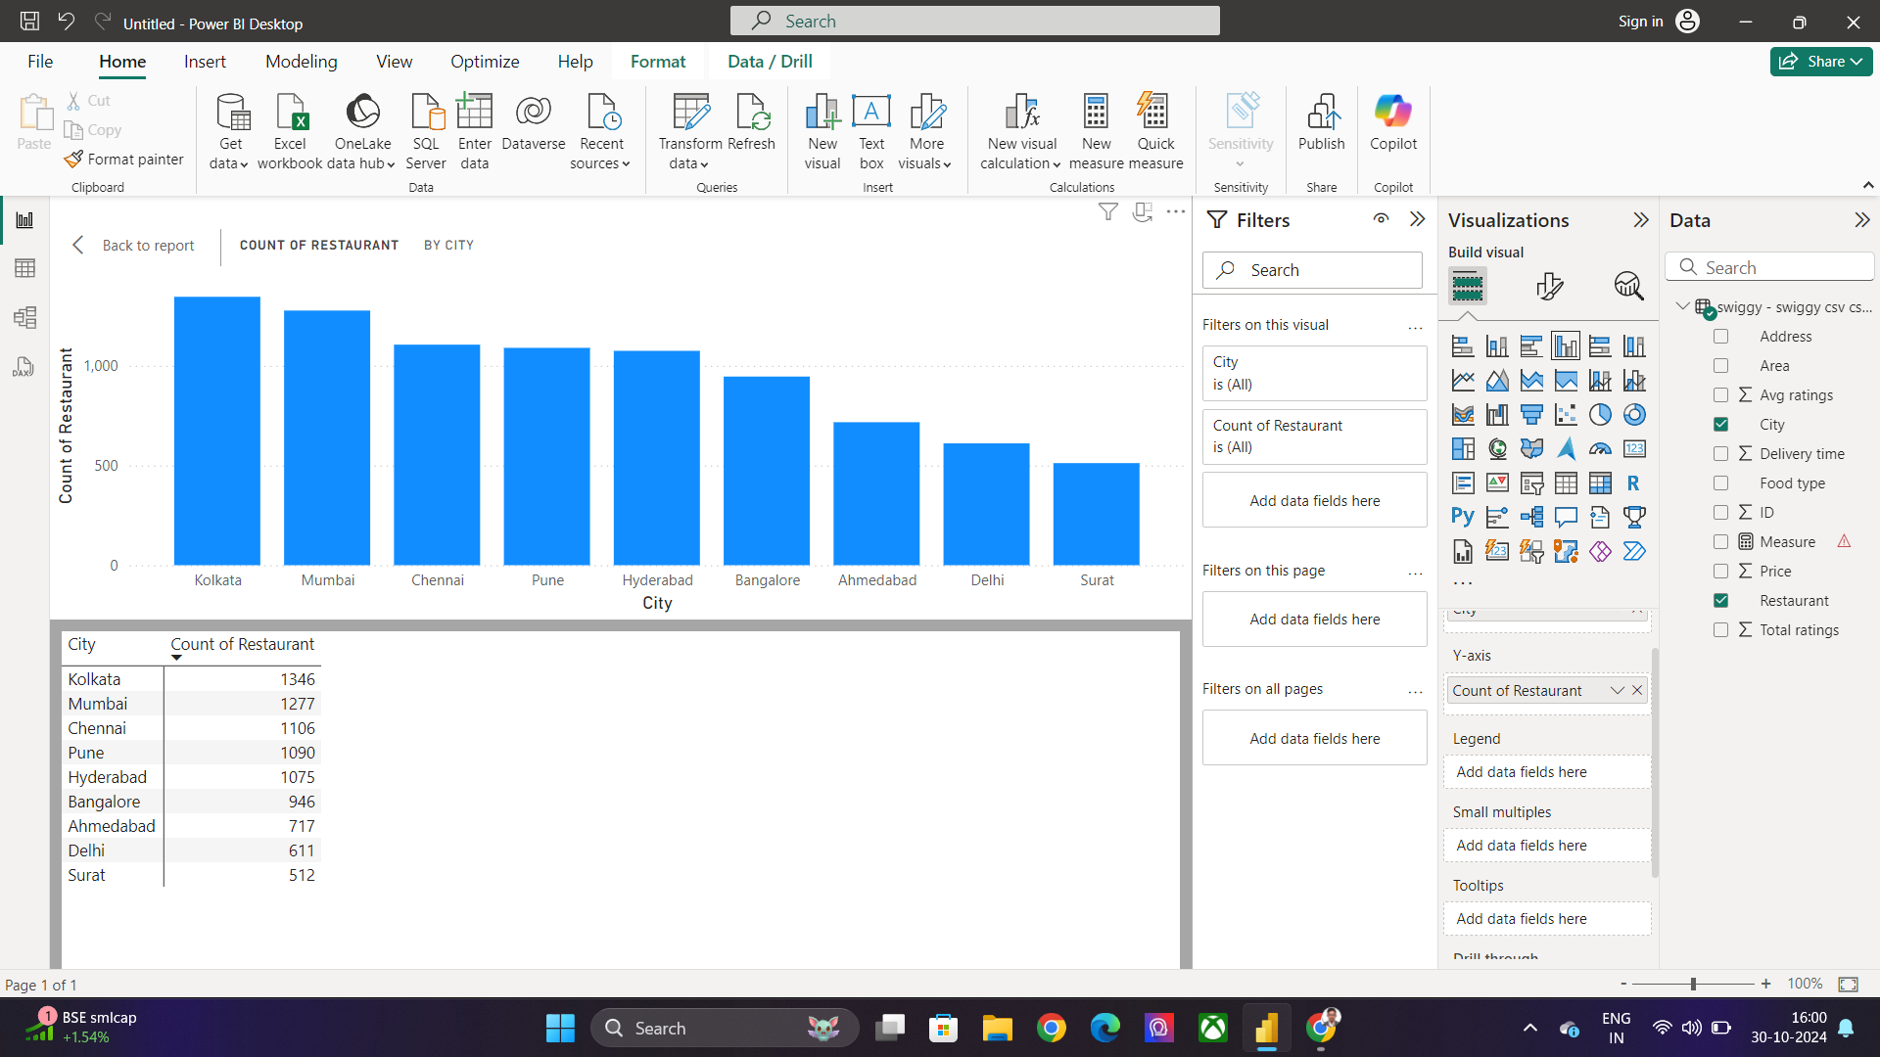
Task 6: City-wise Restaurant Count
1346
1277
1106
1090
1075
946
717
611
512
Conclusion
The city-wise restaurant count data highlights the growing vibrancy of India's food scene, with Kolkata leading the way, followed by Mumbai and Chennai. Kolkata's top position suggests a strong, diverse culinary culture supported by both traditional and modern dining establishments. As India’s cultural and culinary capital, Kolkata's rich food history likely drives a high concentration of restaurants, catering to various tastes and preferences.

Slide 8
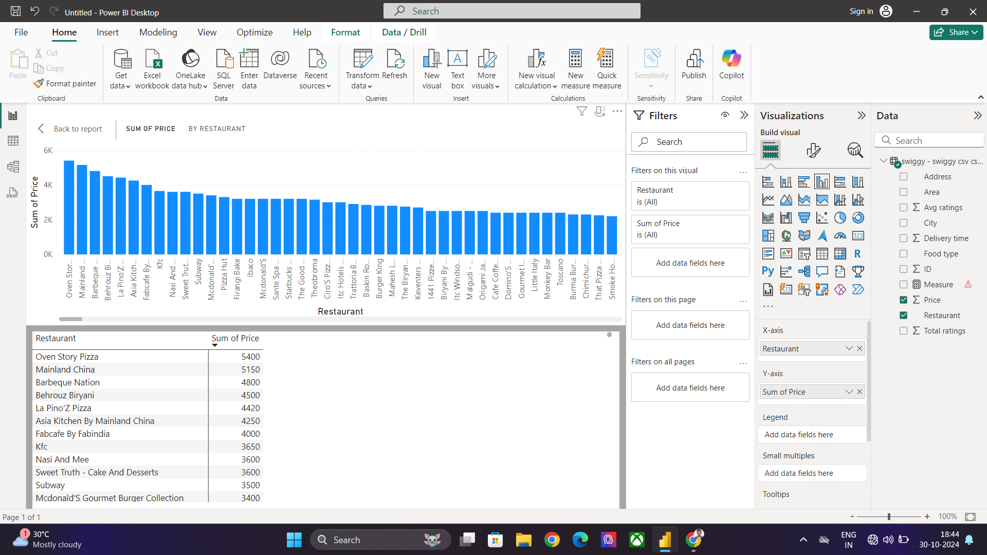
Task 7: Price Analysis
Conclusion
The price analysis of top restaurants—Oven Store, Mainland, and Barbeque—provides valuable insights into how pricing strategies influence consumer perception and dining choices. Oven Store, ranking #1, is likely perceived as offering high-value options with premium pricing, possibly reflecting quality ingredients, specialized cooking methods, or a unique dining experience. Its position at the top suggests that customers are willing to pay a little extra for the perceived quality, which could include an upscale atmosphere, exceptional service, or gourmet offerings.

Slide 9
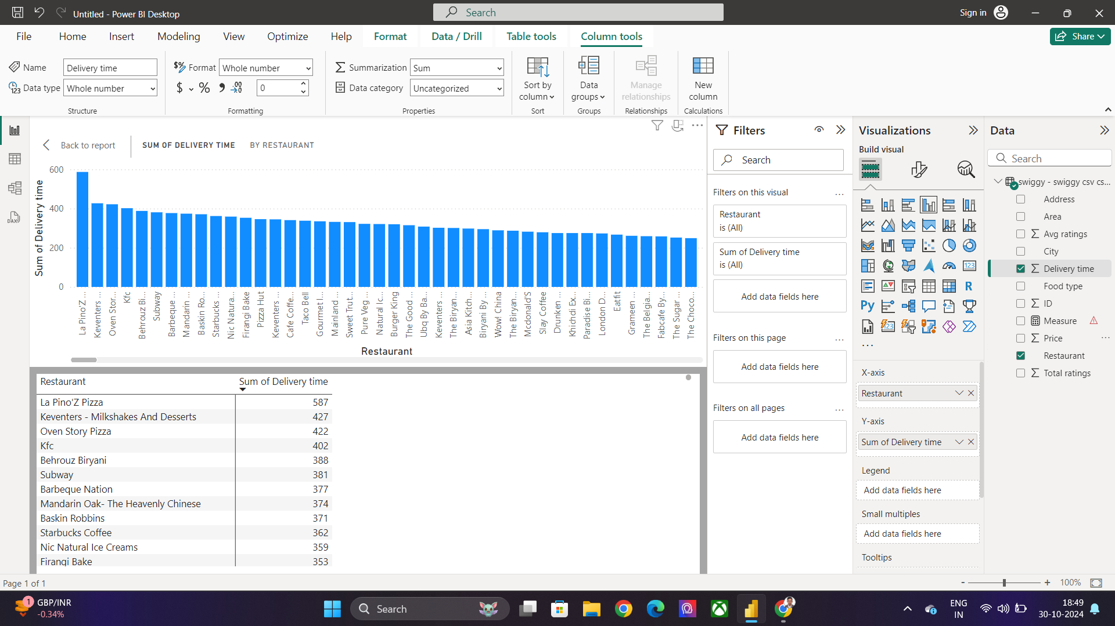
Task 8: Delivery Time Analysis
Conclusion
The Delivery Time Analysis reveals important insights into the efficiency and reliability of restaurant services, with La Pino's, Keventers, and Oven Stores emerging as top performers. La Pino's, ranked first, has proven to excel in delivering fast and timely service, which is a crucial factor in the fast-paced food delivery market. Quick delivery, especially for popular comfort foods like pizzas, helps maintain food quality and enhances customer satisfaction, making it a key reason behind their top ranking.

Slide 10
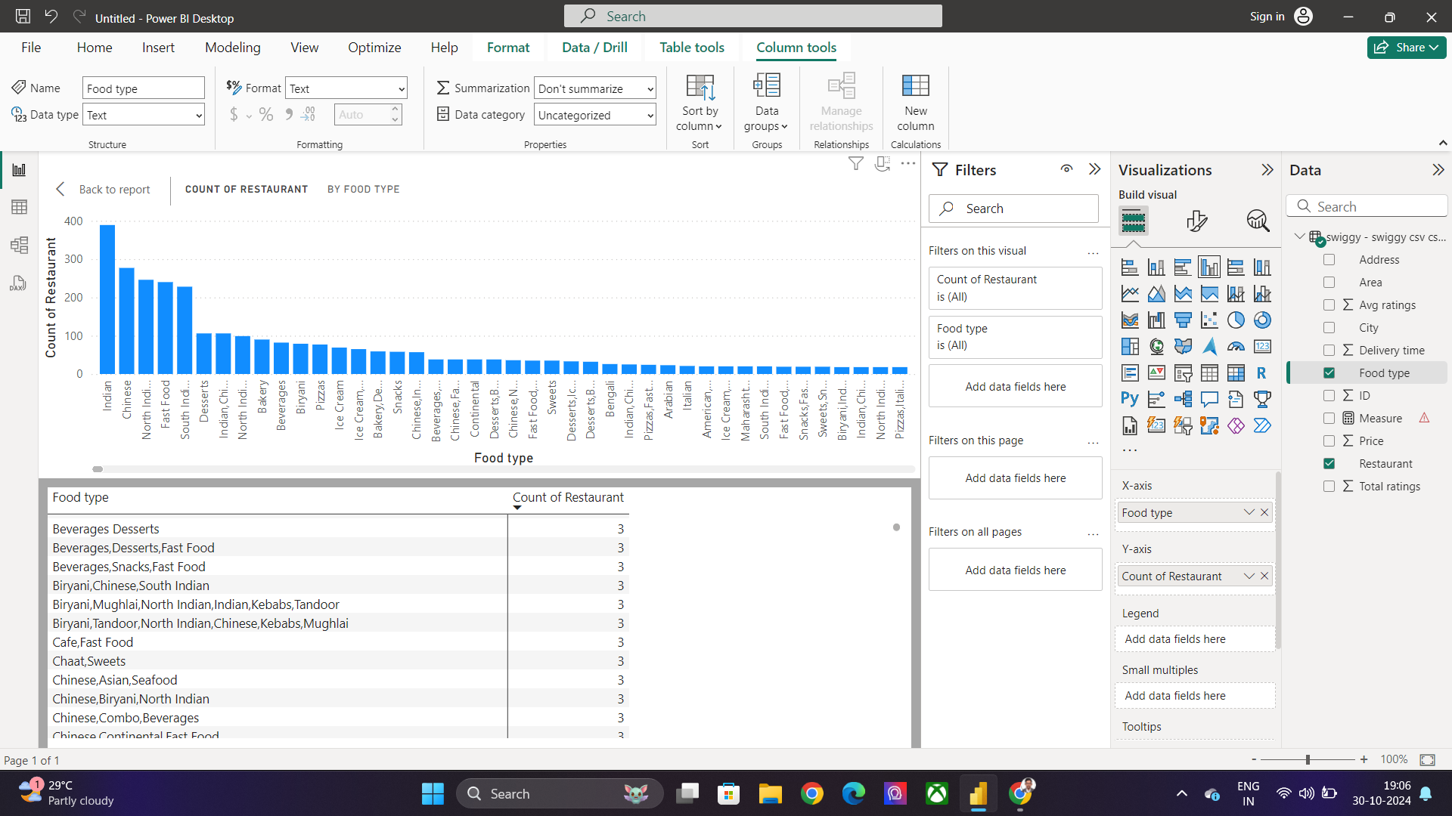
Task 9: Cuisine Analysis
Conclusion:
The Cuisine-Based Analysis reveals a clear preference for diverse yet familiar flavors, with Indian cuisine leading the way, followed by Chinese and North Indian cuisines. Indian cuisine, holding the top spot, reflects its deep cultural roots and broad appeal across regions. The diversity in Indian dishes—from street food to elaborate curries—ensures that there is something for everyone, making it a dominant choice for both casual and traditional dining.

Slide 11
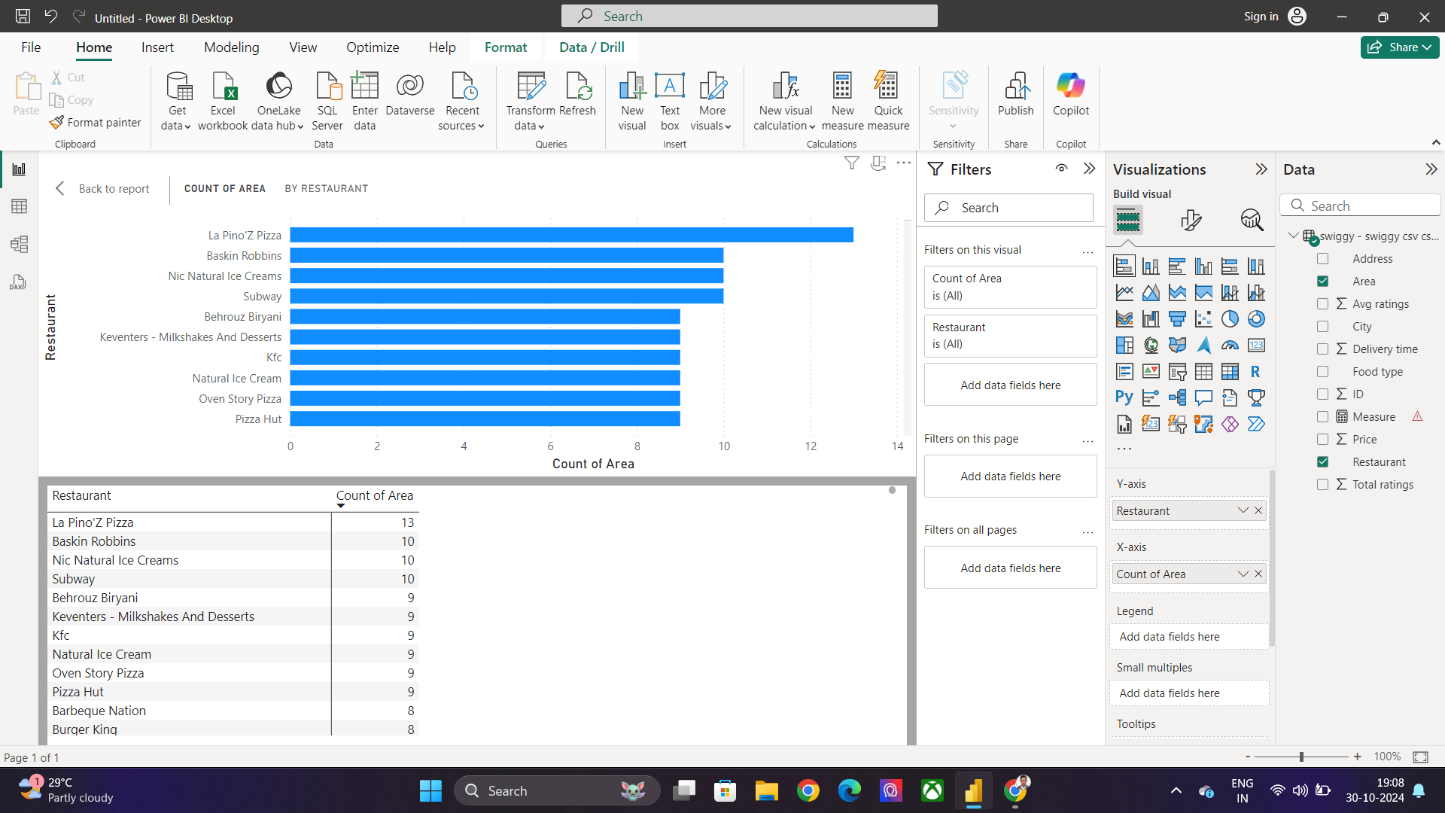
Task10: Area-wise Restaurant Analysis
Conclusion
The Area-wise Restaurant Analysis highlights the reach and popularity of three prominent restaurants: La Pino's Pizza, Biskin Robies, and Nic Natura Ice Cream. La Pino's Pizza, ranked first with a presence in over 12 areas, demonstrates its widespread appeal and success in expanding its footprint across multiple locations. This extensive reach underscores its ability to cater to diverse customer bases and provide consistent service and quality, which has allowed it to become a household name in many areas.

Slide 12
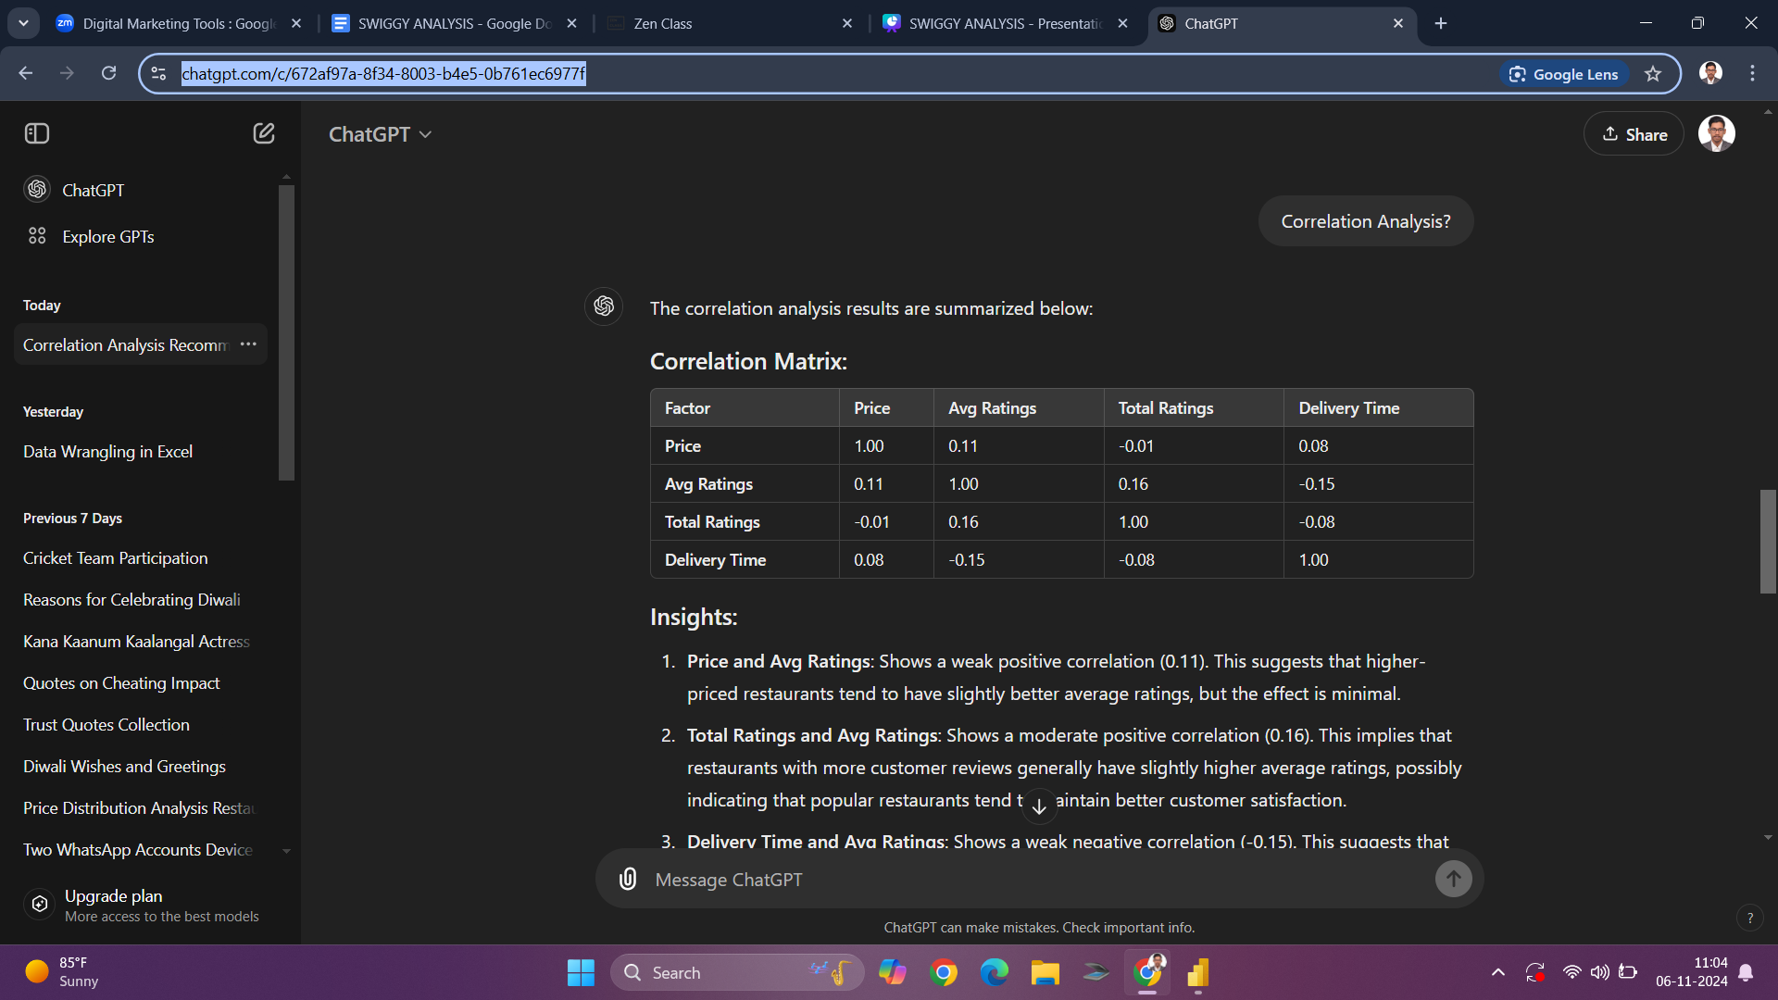
Task 11: Correlation Analysis

Slide 13
Correlation Matrix:
Insights:
Price and Avg Ratings: Shows a weak positive correlation (0.11). This suggests that higher-priced restaurants tend to have slightly better average ratings, but the effect is minimal.
Total Ratings and Avg Ratings: Shows a moderate positive correlation (0.16). This implies that restaurants with more customer reviews generally have slightly higher average ratings, possibly indicating that popular restaurants tend to maintain better customer satisfaction.
Delivery Time and Avg Ratings: Shows a weak negative correlation (-0.15). This suggests that longer delivery times may slightly lower the average rating, highlighting the potential impact of efficient delivery on customer satisfaction.
Interpretation:
Factors like Total Ratings and Delivery Time may have a more noticeable effect on customer satisfaction and average ratings than Price. Delivery Time efficiency might be a critical area for improvement, as delays in delivery correlate negatively with ratings, possibly affecting customer loyalty.

Slide 14
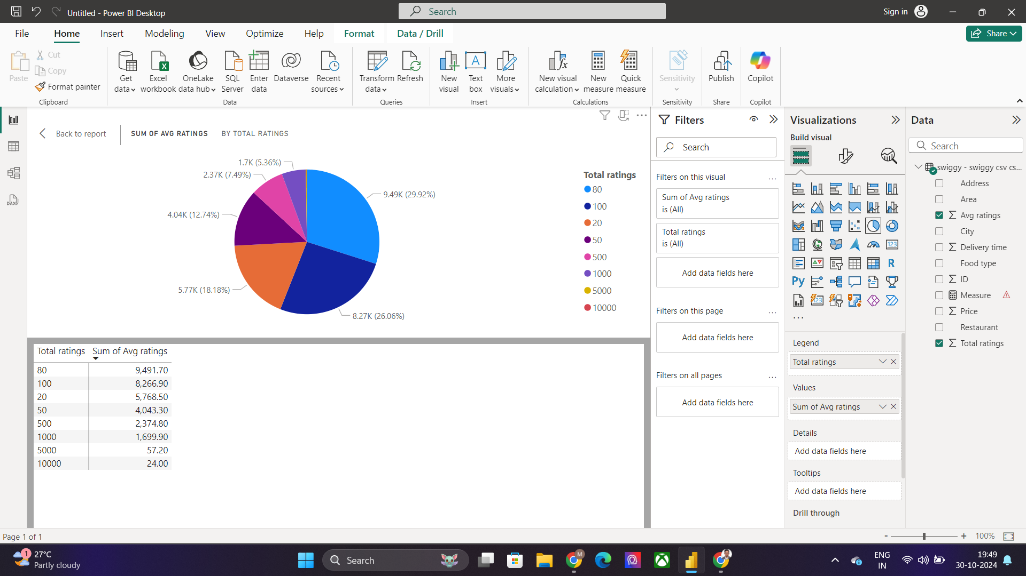
Task 12: Customer Feedback Analysis
Conclusion
The rating distribution analysis—with 29.92% of restaurants receiving an 80 rating, 26.06% receiving a 100 rating, and 18.18% receiving a 20 rating—provides valuable insights into consumer satisfaction and restaurant performance.

Slide 15
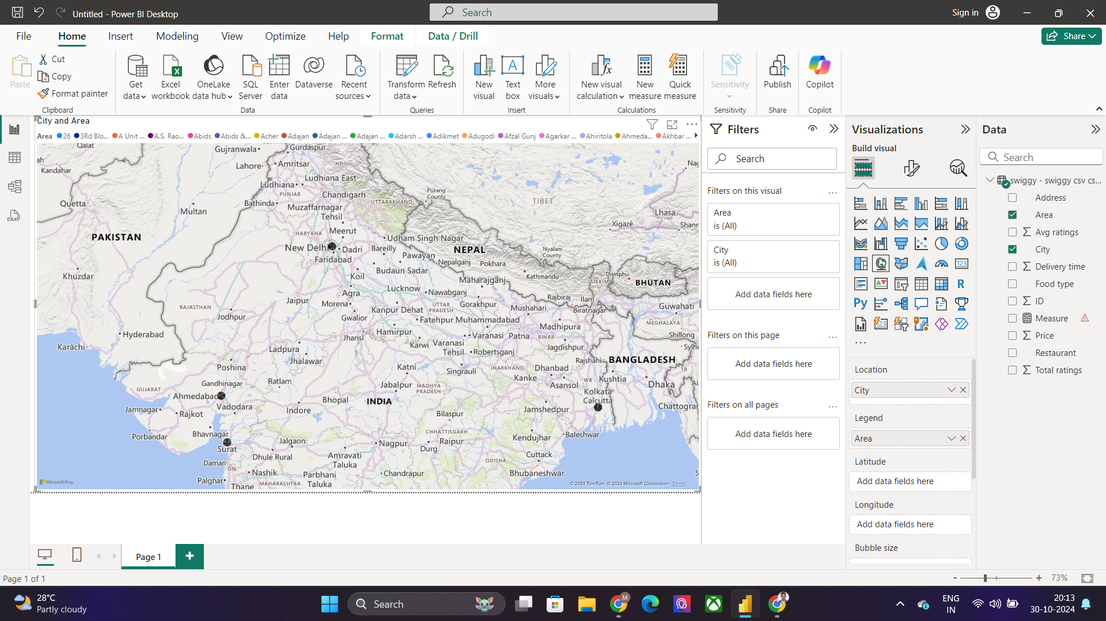
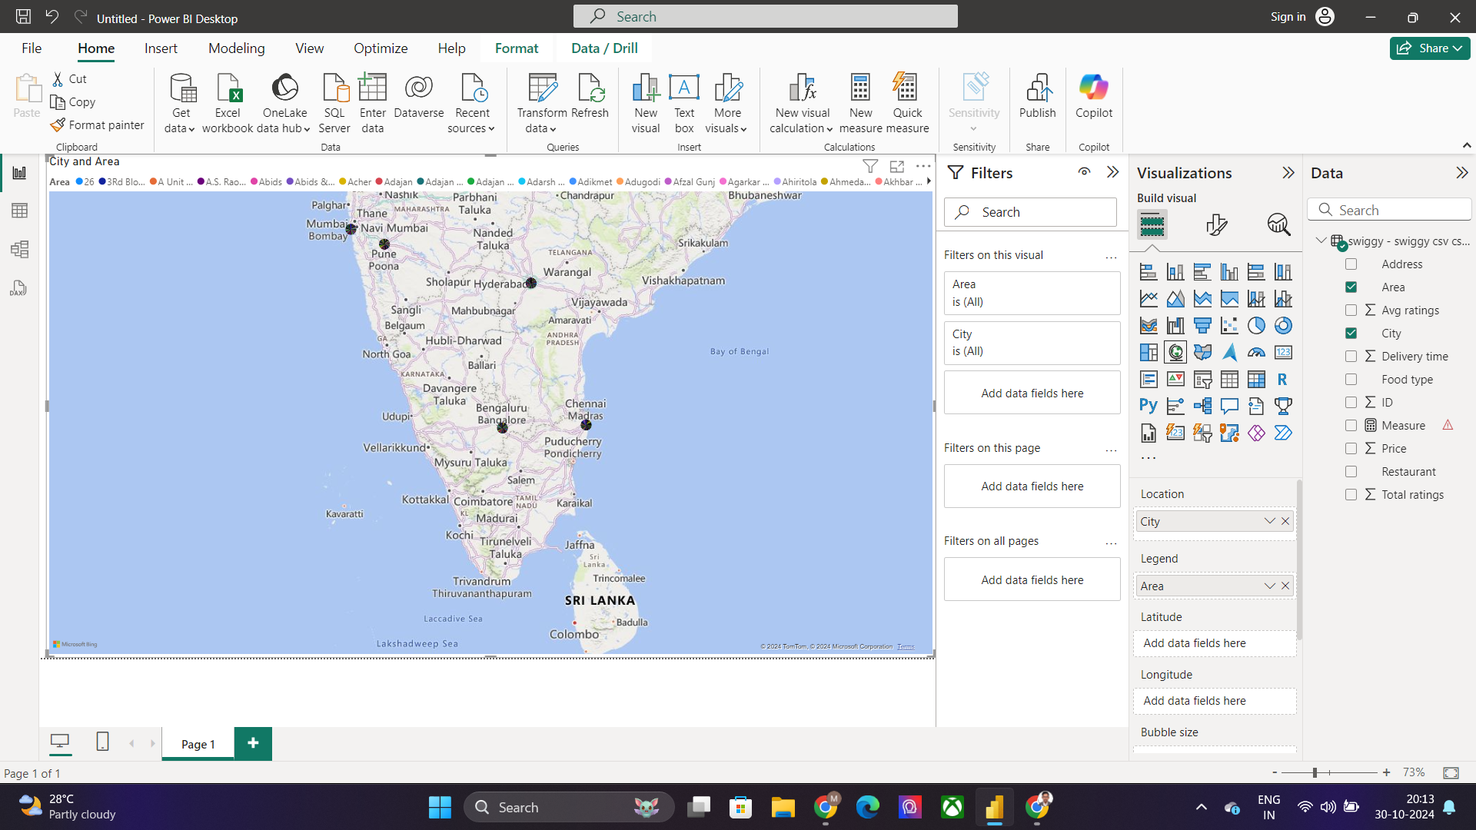
Task 13: Geographical Mapping
Conclusion
The geographical distribution of restaurant locations across major Indian cities such as Ahmedabad, Mumbai, Pune, Hyderabad, Kolkata, Bangalore, and Chennai underscores the vibrant and diverse culinary landscape in India. Each of these cities plays a significant role in shaping the country’s food culture, with distinct regional cuisines and dining preferences contributing to their restaurant scenes.

Slide 16
Task 14: Business Recommendations
1.Focus on Delivery Efficiency: Since delivery time has a negative effect on ratings, improving delivery efficiency could enhance customer satisfaction and average ratings.
2. Pricing Strategy: While price doesn’t strongly affect ratings, slight adjustments to menu prices in line with quality may be beneficial. This could attract customers who correlate higher prices with quality.
3. Encourage Customer Reviews: To increase visibility and reputation, consider promoting incentives for customer feedback. Restaurants with more ratings tend to have better averages, and this trend could help build trust with new customers.

Slide 17

The End

